Slide 1
Random KNN
Arya Bharath & James Wright

Slide 2
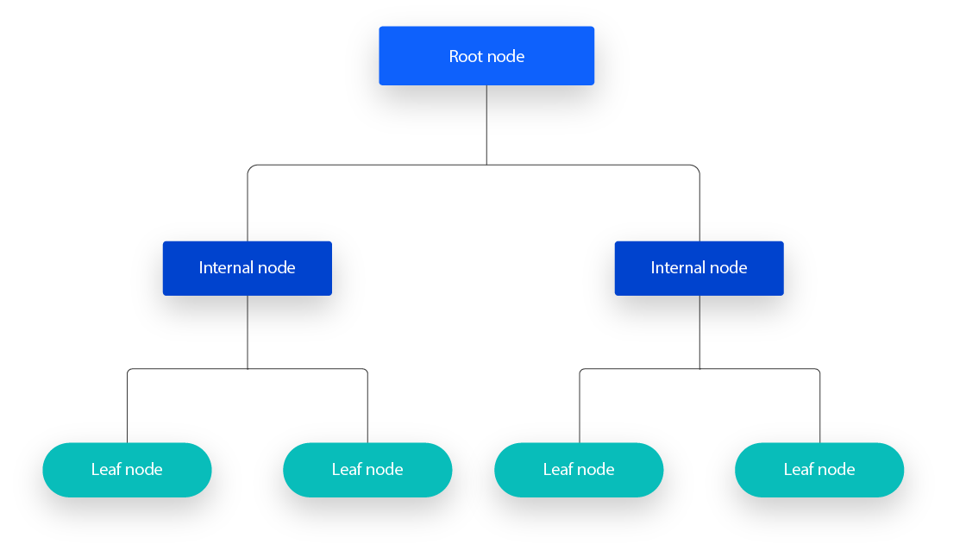
Introduction
Drawn to ensemble learning method
Random Forest uses bagging with Decision Trees
Were Decision Trees the best model for RF?
Random KNN pros
Clustered, nonlinear data
Reducing Decision Tree instability

Slide 3

Related Work
Limited Random KNN research
Shengqiao Li introduced RKNN and its hyperparameters
r: Number of KNNs used in prediction
k: Number of nearest neighbors, 1-15
m: Features per RKNN, sqrt(dimensionality)

Slide 4
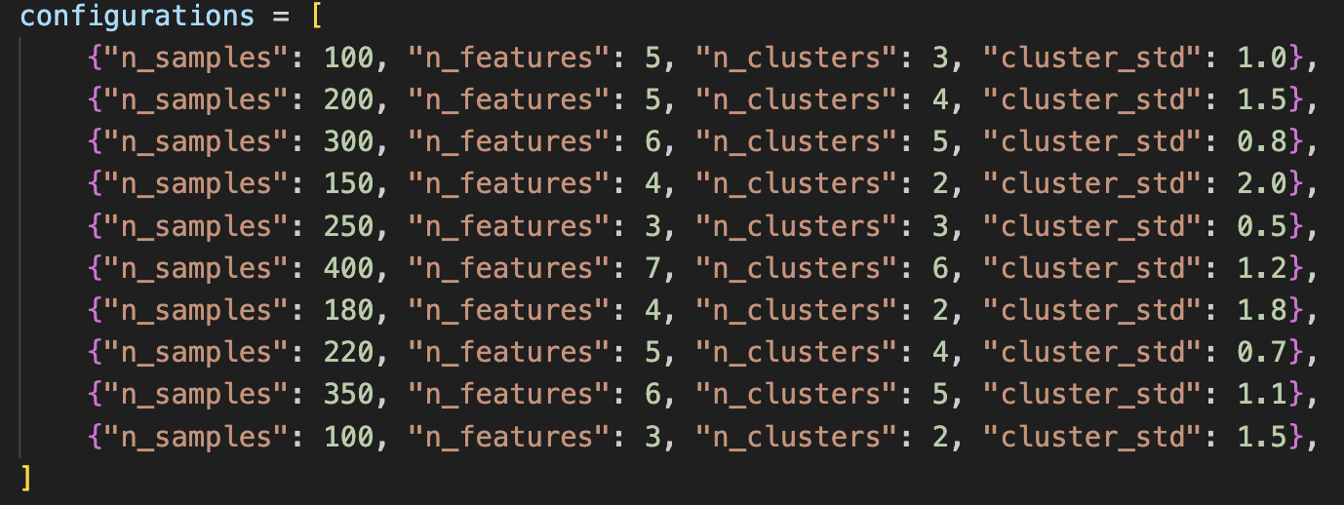
Datasets & Features
Generated artificial datasets using sklearn
Varied samples, features, clusters, standard devs
No need for discretization or normalization
Examples
(100 samples, 5 features, 3 clusters, std 1.0)
(300 samples, 6 features, 5 clusters, std 0.8)

Slide 5
Methods
Random Forest (RF)
Uses bagging to create DTs
Features selected randomly per tree
Predictions made by aggregating votes
K-Nearest-Neighbors (KNN)
Classifies based on distance to neighbors
Different distance metrics (Euclidean, Manhattan)
Random KNN (RKNN)
RF but with KNN instead of DT on sub-samples

Slide 6
Experimental Setup
Generated 10 synthetic datasets
Compared RKNN and RF accuracy
Used square root of sample size for k in RKNN

Slide 7
Results
Sample # | n_samples | n_features | n_clusters | cluster_std | RKNN | RF
1 | 100 | 5 | 3 | 1.00 | 0.63 | 1.00
2 | 200 | 5 | 4 | 1.5 | 1.00 | 1.00
3 | 300 | 6 | 5 | 0.8 | 0.99 | 1.00
4 | 150 | 4 | 2 | 2.0 | 1.00 | 1.00
5 | 250 | 3 | 3 | 0.5 | 1.00 | 0.97
6 | 400 | 7 | 6 | 1.2 | 0.99 | 1.00
7 | 180 | 4 | 2 | 1.8 | 1.00 | 1.00
8 | 220 | 5 | 4 | 0.7 | 1.00 | 1.00
9 | 350 | 6 | 5 | 1.1 | 1.00 | 1.00
10 | 100 | 3 | 2 | 1.5 | 1.00 | 1.00

Slide 8
Results (cont.)
RKNN performs similarly to RF but has inconsistencies.
Most datasets showed RKNN accuracy close to RF.
One dataset (Sample #1) showed significant underperformance.

Slide 9
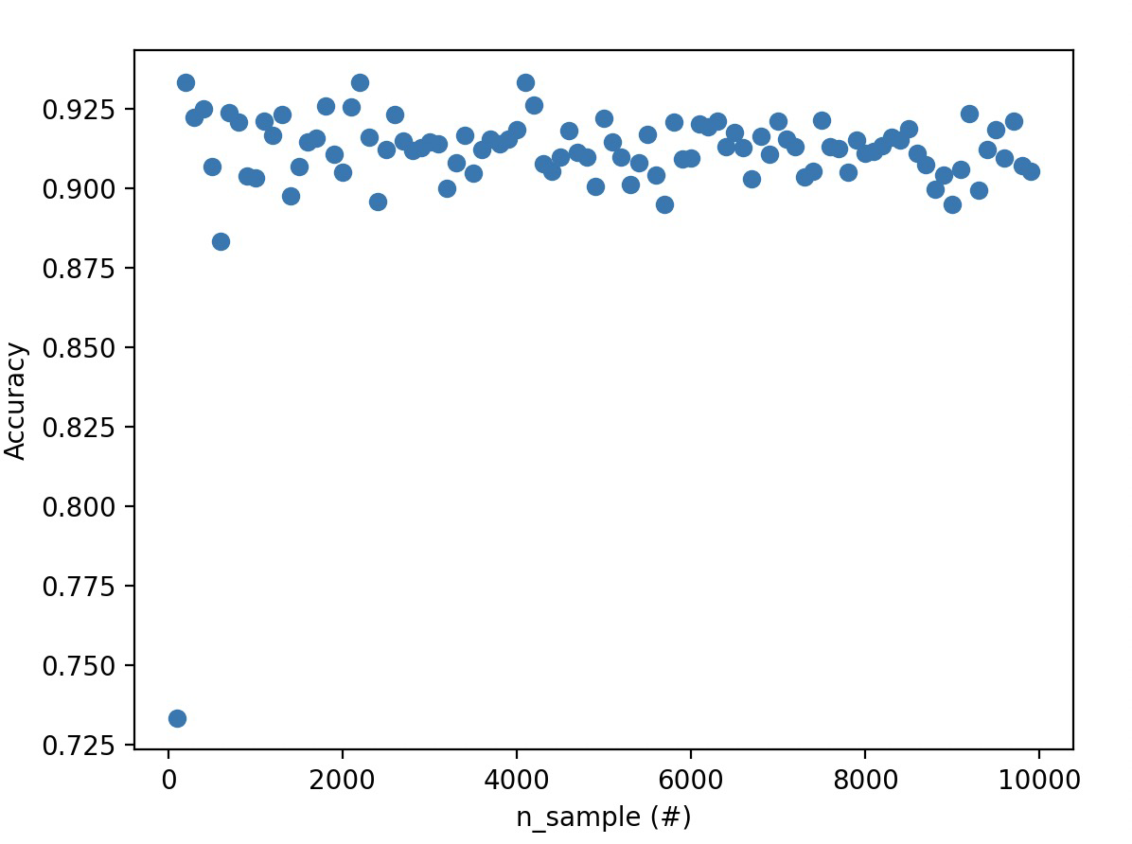
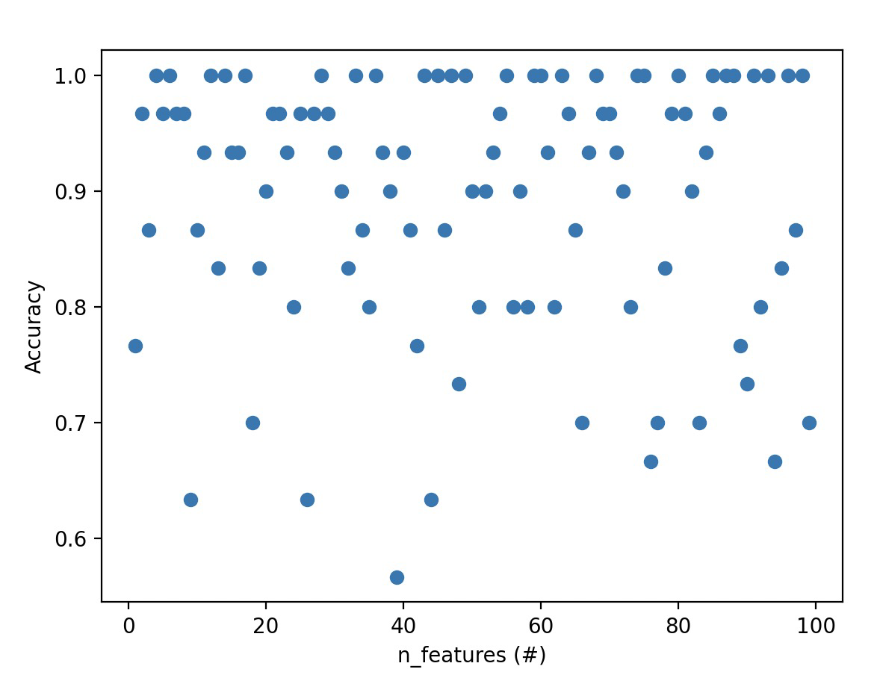
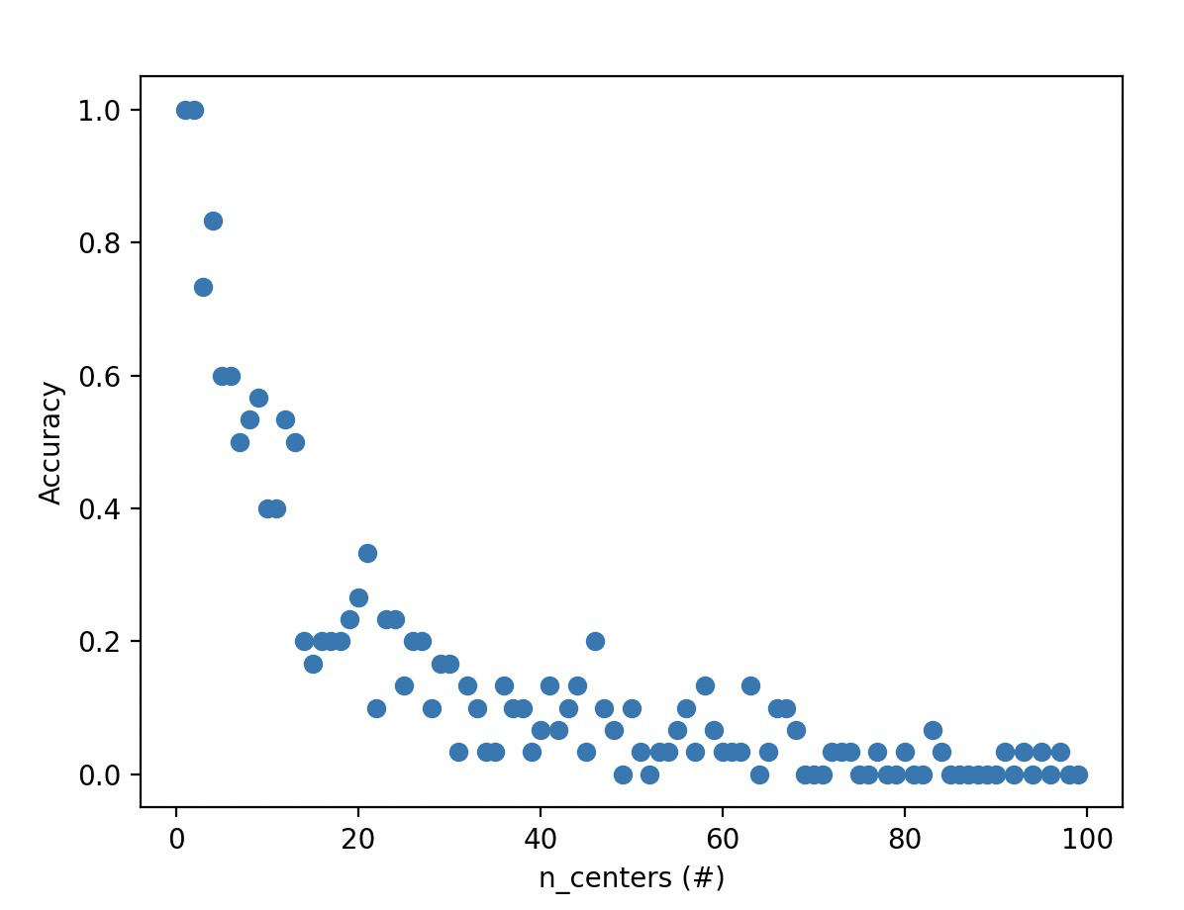
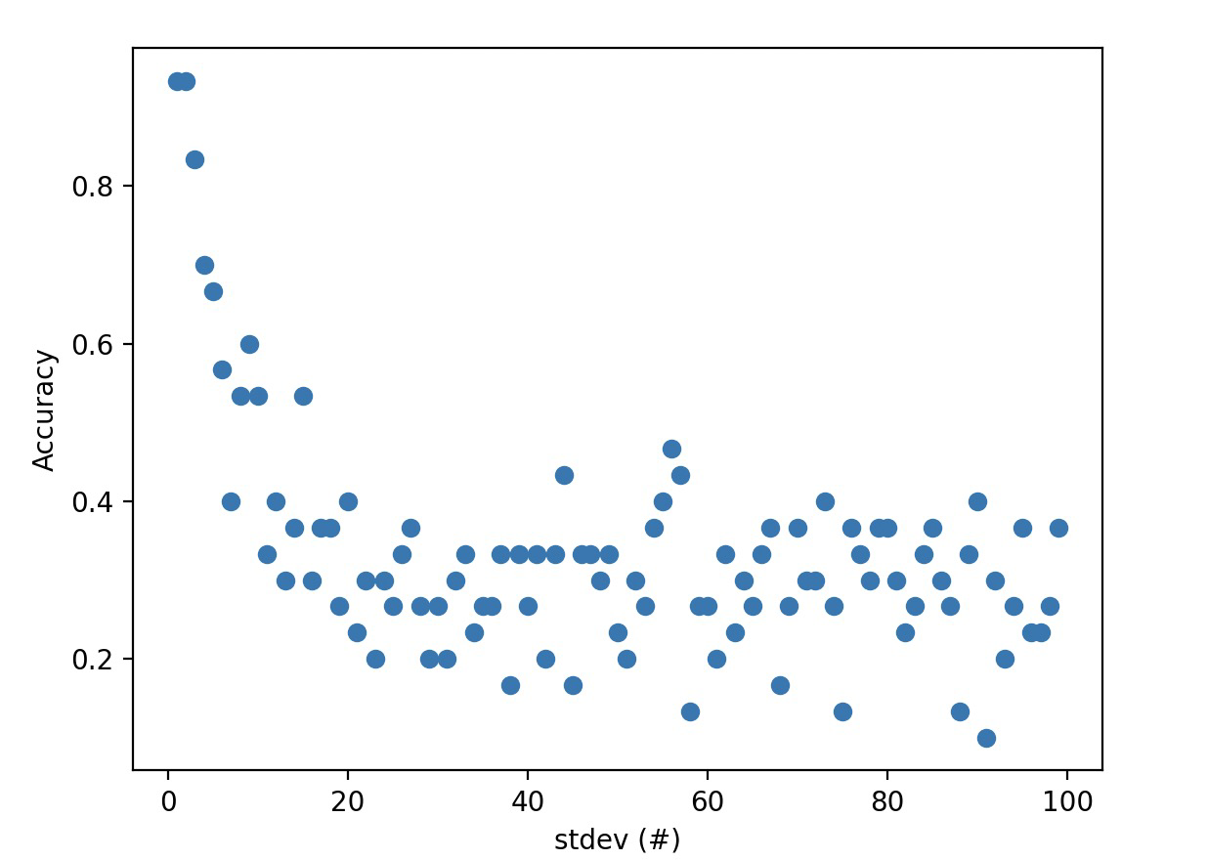

Slide 10
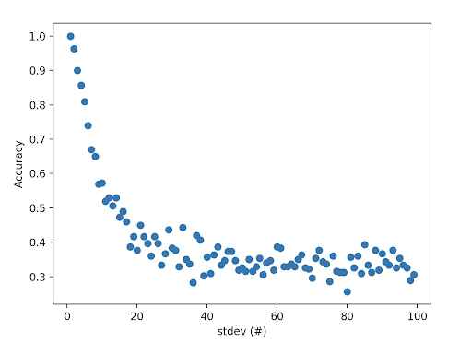
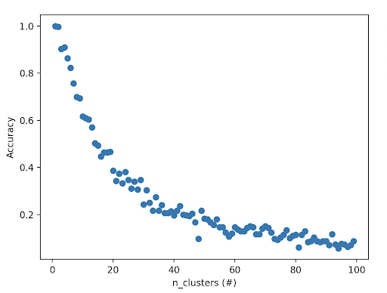
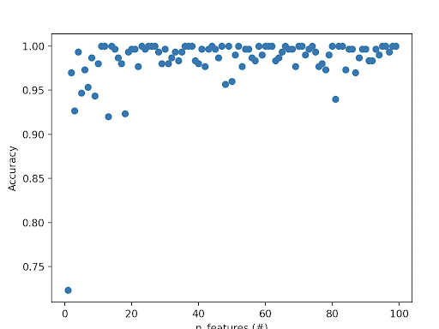
n_sample = 1000

Slide 11
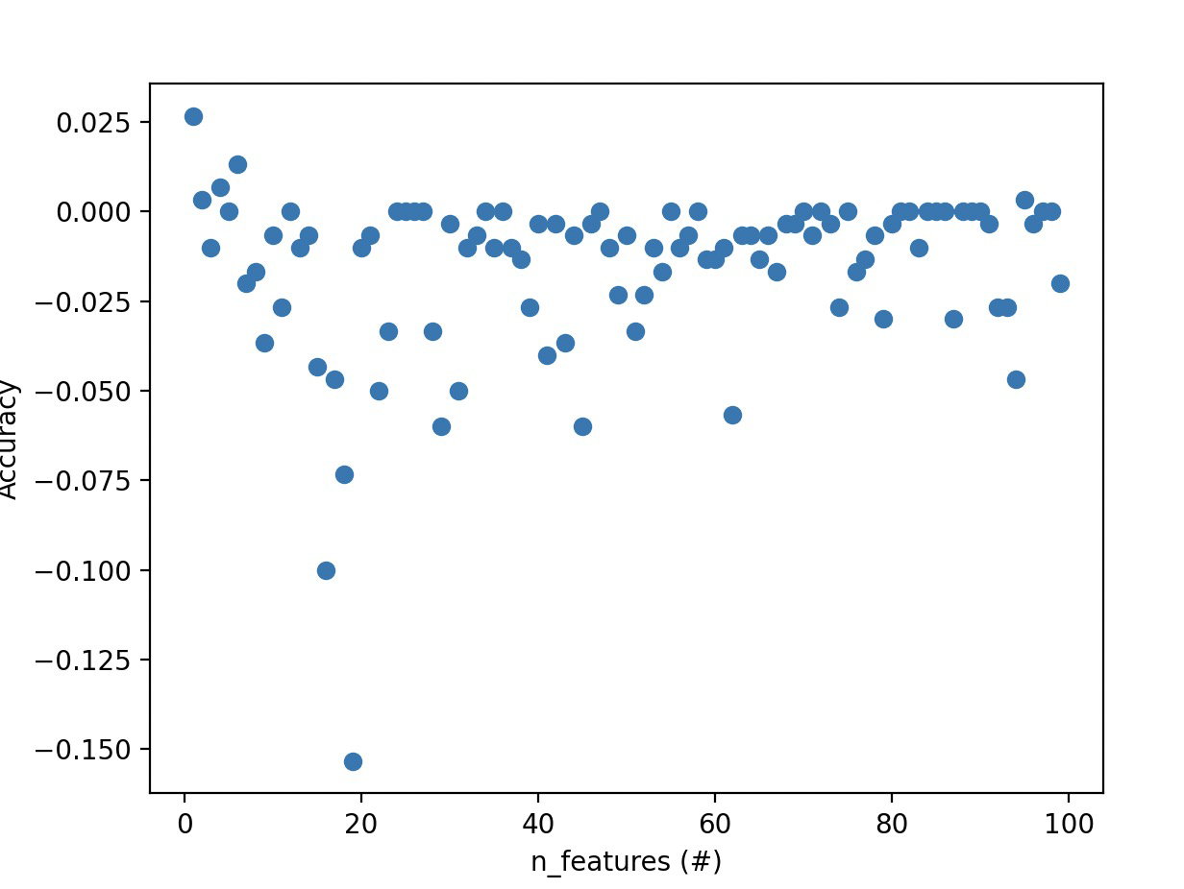
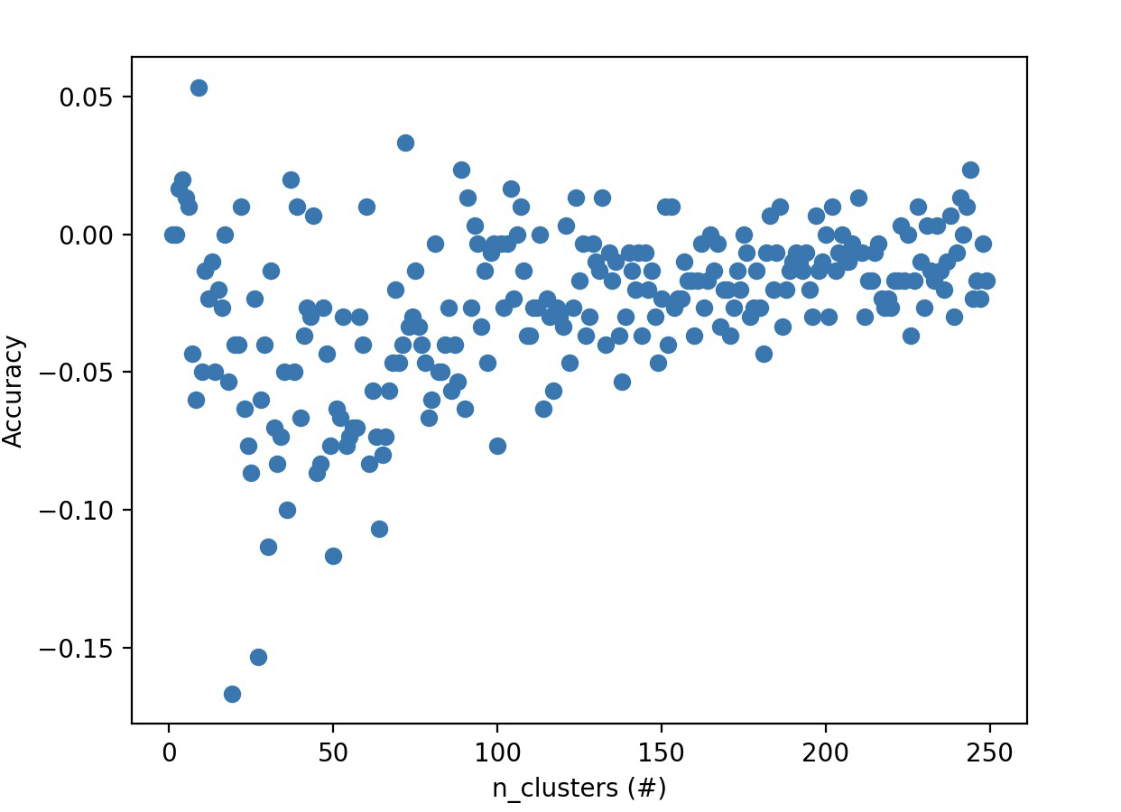
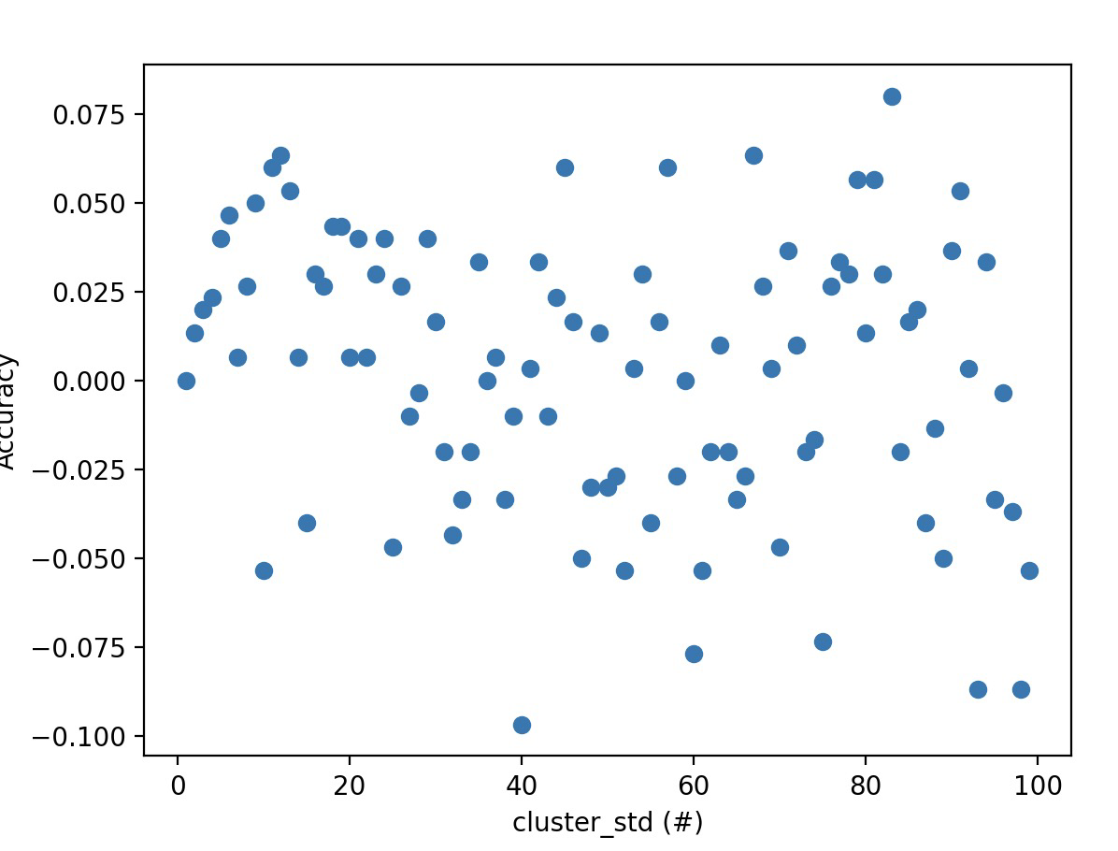
RKNN - RF accuracy
Positive means RKNN >
S = 0.21333333333337

Slide 12
Discussion
Key Findings:
RKNN generally performs well but is sensitive to k selection.
RF is more stable across datasets.
RKNN can underperform if k is poorly chosen.
Potential Improvements
Better hyperparameter tuning (r, k, m).
Analyzing RKNN performance on real-world datasets.

Slide 13
Conclusions & Future Work
RKNN is a viable alternative to RF in certain datasets
Performance variability suggests need for future testing
Extensive testing on diverse datasets
Investigating optimal k selection strategies
Exploring hybrid models combining RF and RKNN

